Slide 1

Phase 1 Project Tittle: AIRCRAFT BUSINESS RISK ASSEMENT
Vincent Buluma

Slide 2
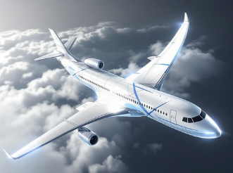
AIRCRAFT BUSINESS RISK ASSESSMENT
Table of content
1. Overview
2. Business Context
3. Data Analysis & Findings
4. Recommendations

Slide 3
Overview
As the world rapidly becomes a global village, air-transport is increasing becoming a key requirement to enable movement of people and goods. Companies across the globe are scrambling to venture into the lucrative air-travel business to address the increasing demand for the same.
This project has been commissioned to review and recommend market entry strategy for West Aviation Ltd based on the analysis of the Aviation_Data on the accidents and fatalities from 1962-2023.
The approach involve data cleaning, imputation, analysis, and visualization to generate insights for the head of aviation in West Aviation Ltd, which is diversifying it's business by introducing an aviation business segment.

Slide 4
Business Context
West Aviation is expanding its portfolio to purchasing and operating airplanes for commercial and private enterprises. They are in the process of undertaking a SWOT analysis in which potential risks of aircraft is a key parameter. The objective of this analysis is determining which aircraft are the lowest risk for the company to start this new business endeavor.
The key output of the analysis is to translate the findings into actionable insights that the head of the new aviation division can use to help decide which aircraft to purchase. This will help the company to capture a sizable market share, Increase customer loyalty by maintaining a clean safety record & maximize profitability.

Slide 5
Data Analysis & Findings
To achieve the objectives, the following tools and techniques have been used analyse the Aviation_Data and draw useful insights:
Data Analysis tools & Techniques:
Python for data cleansing and exploration
Tableau for data visualization.
Findings:
From the analysis, the following findings have been deduced.
Cessna Models have the highest number of accidents, followed by piper
Cessna has the highest number injuries
Boeing 737 is the safest plane by far in terms of uninjured customers whenever an accident occurs, however, 737 is still the most destroyed Boeing family whenever it is involved in the accident
Aircrafts with 1 Engine are prone to accidents that those with 2 engines. & Aircrafts with reciprocating and Turbo Shaft engine types are prone to accidents
.

Slide 6
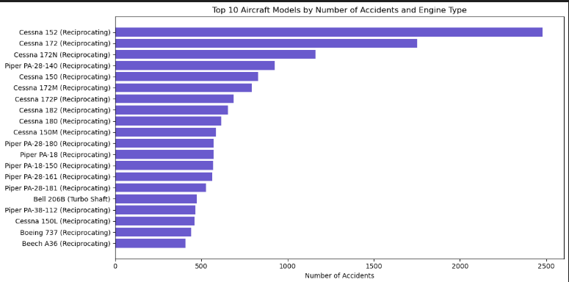
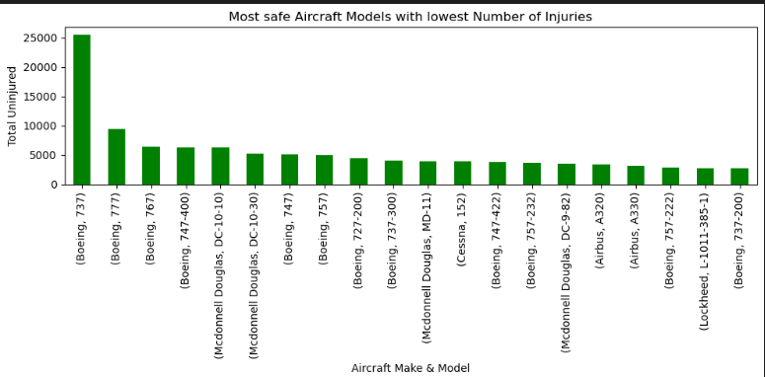
Data Analysis & Findings ...

Slide 7
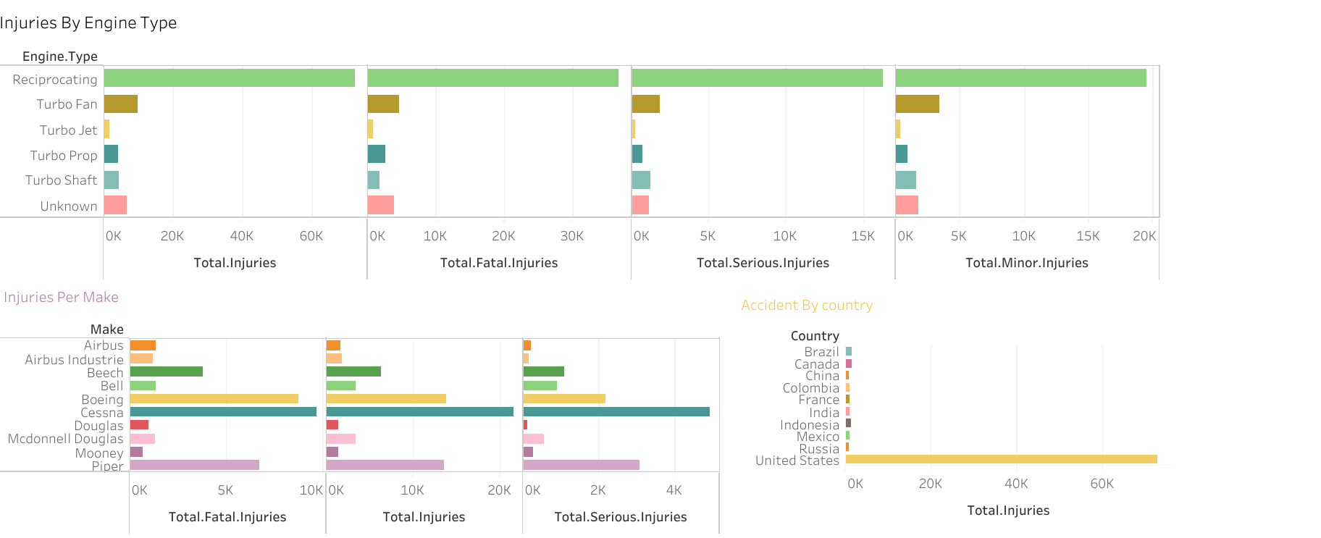

Slide 8
Recommendations
The following are the recommendations based on the findings:
1. Cessna Models have the highest number of accidents and fatalities, therefore, the company should minimize or avoid purchasing Cessna aircrafts especially models 152, 172 & 172N
2. Boeing is the safest aircraft as it has highest uninjured passengers in case of accident and fewer aircrafts damaged during an accident, therefore, the company should Maximize/optimize purchasing of Boeing aircrafts especially models 737.
3. Most accidents involve aircraft with 1-engine, therefore the company should buy aircrafts with more than 1 engine to reduce the risk of accidents

Slide 9


Q&A
&
Contact Details
Name: Vincent Buluma

